Slide 1
Image Filtering in Spatial & Frequency Domain Course: Digital Image Processing
Semester: BSCS 5th University: GCUF Instructor: Adnan Majeed

Slide 2
1. INTRODUCTION TO IMAGE FILTERING
Image filtering is the process of modifying or enhancing an image by applying mathematical operations to its pixels. It is mainly used for:
Noise removal
Image smoothing
Edge detection
Sharpening
Feature extraction
Filtering is performed in two major domains:
Spatial Domain
Frequency Domain

Slide 3
2. SPATIAL DOMAIN FILTERING
Spatial filtering directly operates on image pixels. A spatial filter consists of:
A kernel / mask / filter window (e.g., 3×3, 5×5)
A rule for modifying pixel values using neighbors

Slide 4
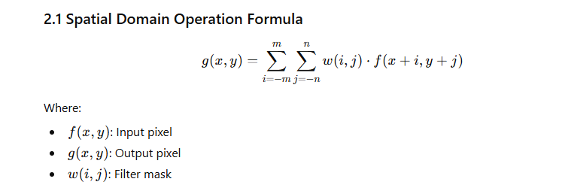

Slide 5
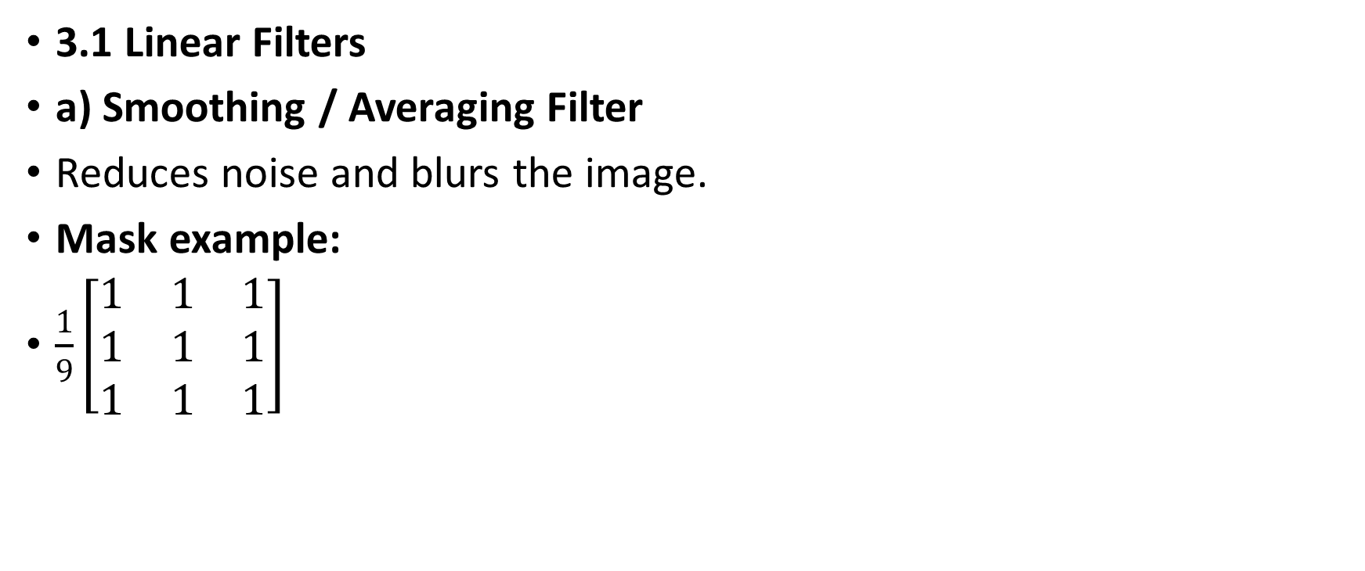
3. TYPES OF SPATIAL FILTERS
3.1 Linear Filters
a) Smoothing / Averaging Filter
Reduces noise and blurs the image.
Mask example:
$\frac{1}{9}\left[\begin{matrix}1 & 1 & 1 \\ 1 & 1 & 1 \\ 1 & 1 & 1\end{matrix}\right]$

Slide 6
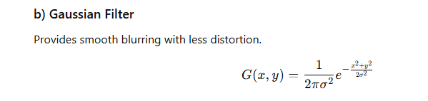

Slide 7

c) Sharpening Filter – Laplacian
Enhances edges.
$\left[\begin{matrix}0 & −1 & 0 \\ −1 & 4 & −1 \\ 0 & −1 & 0\end{matrix}\right]$

Slide 8
3.2 Non-Linear Filters
a) Median Filter
Removes salt-and-pepper noise.
b) Max & Min Filter
Used in morphological operations.

Slide 9
4. FREQUENCY DOMAIN FILTERING
Frequency domain represents an image using sinusoidal components.
Steps:
Convert image to frequency domain using DFT
Apply Filter (Low-pass, high-pass, band-pass)
Convert back using IDFT

Slide 10
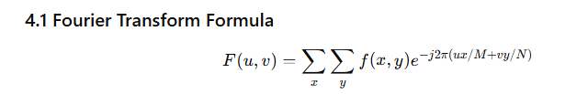

Slide 11
5. TYPES OF FREQUENCY DOMAIN FILTERS
5.1 Low Pass Filter (LPF)
Keeps low frequencies → smooth image.
5.2 High Pass Filter (HPF)
Keeps high frequencies → sharp edges.
5.3 Bandpass Filter
Allows mid-frequency components.

Slide 12
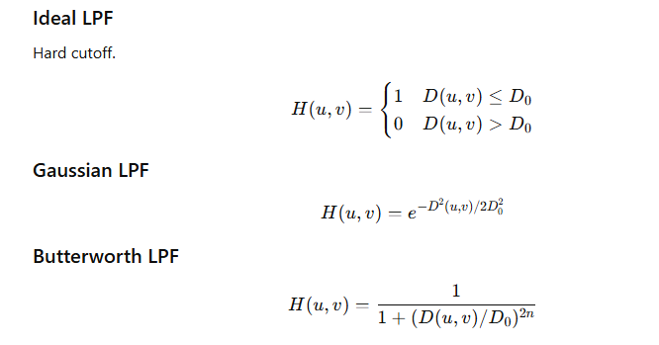
6. IDEAL, GAUSSIAN & BUTTERWORTH FILTERS

Slide 13
7. PRACTICALS USING PYTHON (OpenCV, NumPy, Matplotlib)
✅ 7.1 Spatial Domain Filtering – Python Code
import cv2
import numpy as np
import matplotlib.pyplot as plt
img = cv2.imread('lena.png', 0)
plt.imshow(img, cmap='gray')
plt.title("Original Image")
plt.show()

Slide 14
(b) Averaging Filter
kernel = np.ones((5,5), np.float32) / 25
avg = cv2.filter2D(img, -1, kernel)
plt.imshow(avg, cmap='gray')
plt.title("Averaging Filter")
plt.show()

Slide 15
c) Gaussian Filter
gauss = cv2.GaussianBlur(img, (5, 5), 0)
plt.imshow(gauss, cmap='gray')
plt.title("Gaussian Filter")
plt.show()

Slide 16
(d) Median Filter
median = cv2.medianBlur(img, 5)
plt.imshow(median, cmap='gray')
plt.title("Median Filter")
plt.show()

Slide 17
(e) Laplacian Sharpening
lap = cv2.Laplacian(img, cv2.CV_64F)
lap = np.uint8(np.absolute(lap))
plt.imshow(lap, cmap='gray')
plt.title("Laplacian Sharpening")
plt.show()

Slide 18
✅ 7.2 Frequency Domain Filtering – Python Code
(a) Fourier Transform
f = np.fft.fft2(img)
fshift = np.fft.fftshift(f)
magnitude = 20*np.log(np.abs(fshift))
plt.imshow(magnitude, cmap='gray')
plt.title("Fourier Spectrum")
plt.show()

Slide 19
(b) Ideal Low Pass Filter (LPF)
rows, cols = img.shape
crow, ccol = rows//2, cols//2
D0 = 50
mask = np.zeros((rows, cols), np.uint8)
mask[crow-D0:crow+D0, ccol-D0:ccol+D0] = 1
fshift_lpf = fshift * mask
f_ishift = np.fft.ifftshift(fshift_lpf)
img_back = np.fft.ifft2(f_ishift)
img_back = np.abs(img_back)
plt.imshow(img_back, cmap='gray')
plt.title("Ideal Low Pass Filter")
plt.show()

Slide 20
(c) High Pass Filter (HPF)
mask = np.ones((rows, cols), np.uint8)
mask[crow-30:crow+30, ccol-30:ccol+30] = 0
fshift_hpf = fshift * mask
f_ishift = np.fft.ifftshift(fshift_hpf)
img_back = np.fft.ifft2(f_ishift)
img_back = np.abs(img_back)
plt.imshow(img_back, cmap='gray')
plt.title("High Pass Filter")
plt.show()

Slide 21
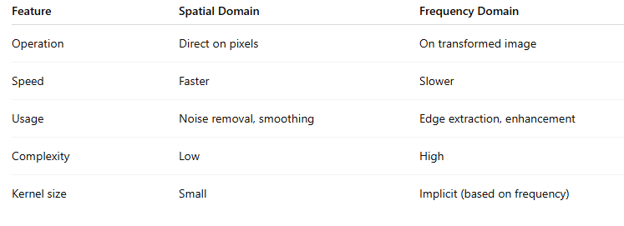
8. COMPARISON: SPATIAL VS FREQUENCY FILTERING

Slide 22
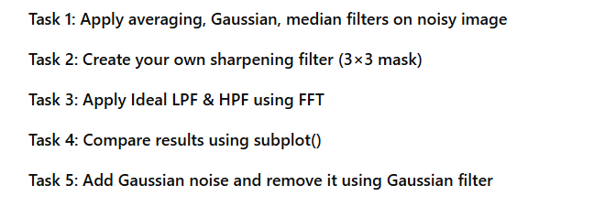
9. LAB TASKS (For Students)Useful for BSCS 5th Semester Assignments / Exams

Slide 23
10. CONCLUSION
Spatial filters work directly on pixels and are easy to implement. Frequency domain filtering is powerful for extracting image features. Both domains complement each other and are essential in Digital Image Processing.

